Slide 1
NAME: Soumili Mukherjee
ROLL: 21MT10054
Sec-2
Functional Programming (Features and comparative study)
[Selection Round Task- Kharagpur Open Source Society, IIT Kharagpur]

Slide 2

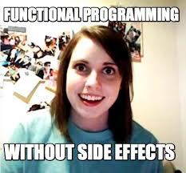

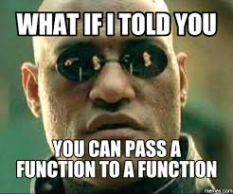

Functional Programming
Presence of functions== Functional programming????

Slide 3

Paradigms of Programming
Makes it easier to perform Paradigm P
Paradigm??? What is that??
Way of Doing Something!!!
P
A
B
Paradigm is basically the process of doing any task. It is not a concrete thing like programming . However if we have two programming languages A and B……
B is a P language.
Lets see the different types of paradigms now

Slide 4
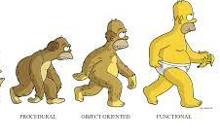
Types of Paradigms
Procedural
All about giving orders!!!!
Object Oriented
All about classes and their objects!!!
Functional
Functions are captains of the ship here!!!
Lets find out more about them
Functional programming is cool it seems r8??

Slide 5
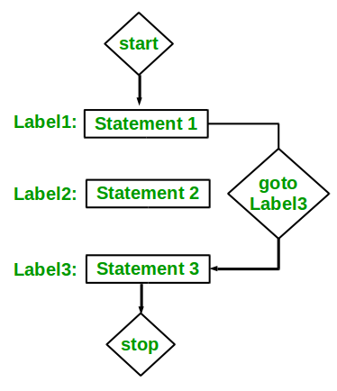

Procedural Programming
Here computation takes place by commands. Commands in every line decide the results. To understand better have a peek at the flow-chart below!!!
Seems pretty strict!!

Slide 6
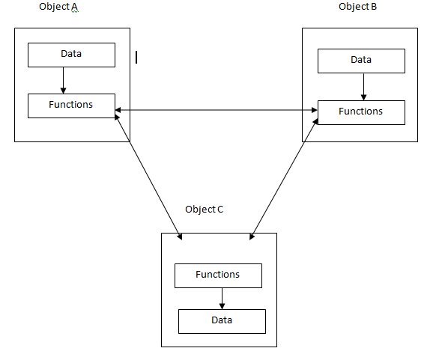
Object Oriented Programming
OOP is based on the sending of messages to objects. Objects respond to messages by performing operations, generally called methods. Messages can have arguments. A society of objects, each with their own local memory and own set of operations has a different feel than the monolithic processor and single shared memory feel of non object oriented languages.
Everyone seems to mind their own business here

Slide 7

Functional Programming- The limelight of our discussion
In simple terms functional programming is a paradigm which uses functions to the best of their effect to create clean and maintainable programs . To understand this first let us define our hero-Functions!!
Chopping machine
Functions:a block of organized code that is used to perform a single task.
They can also be defined as subprograms which can be used again and again in a program.
Function to chop fruits

Slide 8

Lets explore more about functions…
Types of Functions
Pure Functions
Here functions only work with the input given to them and return an output. They tend not to modify values or create actions which might lead to changes or “SIDE EFFECTS”
Impure Functions
Here functions always have tendency to modify values of variables . They can cause side effects and be the reasons of bugs.
Lets understand them with some code

Slide 9
Lets Have A look At the code snippets written in Python
Both give the same output and look pretty same right? How do we differentiate?
x3=10
def add (x1,x2):
result=x1+x2
return(result)
print(add(12,10))
A
x3=10
def add (x1):
result=x1+x3
return(result)
print(add(12))
B
Well, here when we are adding the two numbers we are making use of the global variable x3 though we haven’t mentioned it anywhere in the function input. This is a sign of impurity and the function works with some variable with which it is not directly connected.
This is a pure version of code A. Here the functions work only with inputs given.
A bit confusing?? No worries, lets make our concepts clear with some more examples.

Slide 10
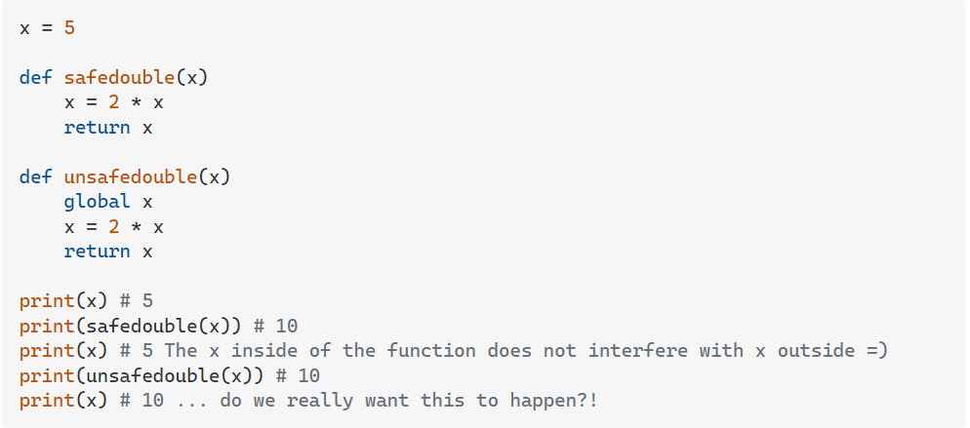

Pure Function, does not modify value.
Impure Function, modifies value
This modification of values is ‘SIDE EFFECT’
These pure functions are what defines Functional Programming. Pure functions in cases of long codes make debugging much more easier as all you have to do is check every function because there is no interference of outer variables nor any modification taking place.
Though the code snippets are in python,it is not a purely functional programming language
This is the reason why functional programming follows Purely Functional data structure as this paradigm does not rely on mutable data.

Slide 11

1]Thus, pure functions are one of the main features which differentiates functional programming and object oriented programming.
Object oriented programming generally uses mutable data while functional programming works with immutable data.
2]Another major difference that arises in between functional programming and object oriented programming is that use of iterative loops. Unlike object oriented programming , Functional programming makes use of functions like map , reduce and filter.
Remember that lambda sign in our first slide? Now, we will see how this lambda can be used as an alternative of long iterative loops.
So, why wait, lets explore more…..

Slide 12
To understand the second difference mentioned in previous slide, we need to learn about Lambda functions.
Lambda Functions
A lambda function is a small anonymous function.
A lambda function can take any number of arguments, but can only have one expression.
Lambda functions are tools that can be used to make a program functional. But you can use lambdas in object-oriented programming, too.
Syntax: lambda arguments : expression
x = lambda a : a + 10 print(x(5))
Output:15
x = lambda a, b, c : a + b + c print(x(5, 6, 2))
Output:13
We can even declare lambda functions inside other functions . Lambda functions can even be returned from other functions thus reinforcing the use of higher order functions. Lets see…..

Slide 13

More about Lambda functions…
def myfunc(n): return lambda a : a * n mydoubler = myfunc(2) mytripler = myfunc(3) print(mydoubler(11)) print(mytripler(11
Example of lambda function being returned from one function. This reflects the Higher order functionality of functional programming.
Now, you might be wondering how this lambda helps in looping in programs. Well, in functional programming we rely on recursion(calling of function itself) or higher order functions through certain constructs like map, filter,reduce .Interesting isn’t it?
So let’s move and learn about map,filter and reduce….the HEART of Functional Programming.

Slide 14
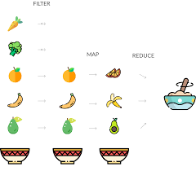
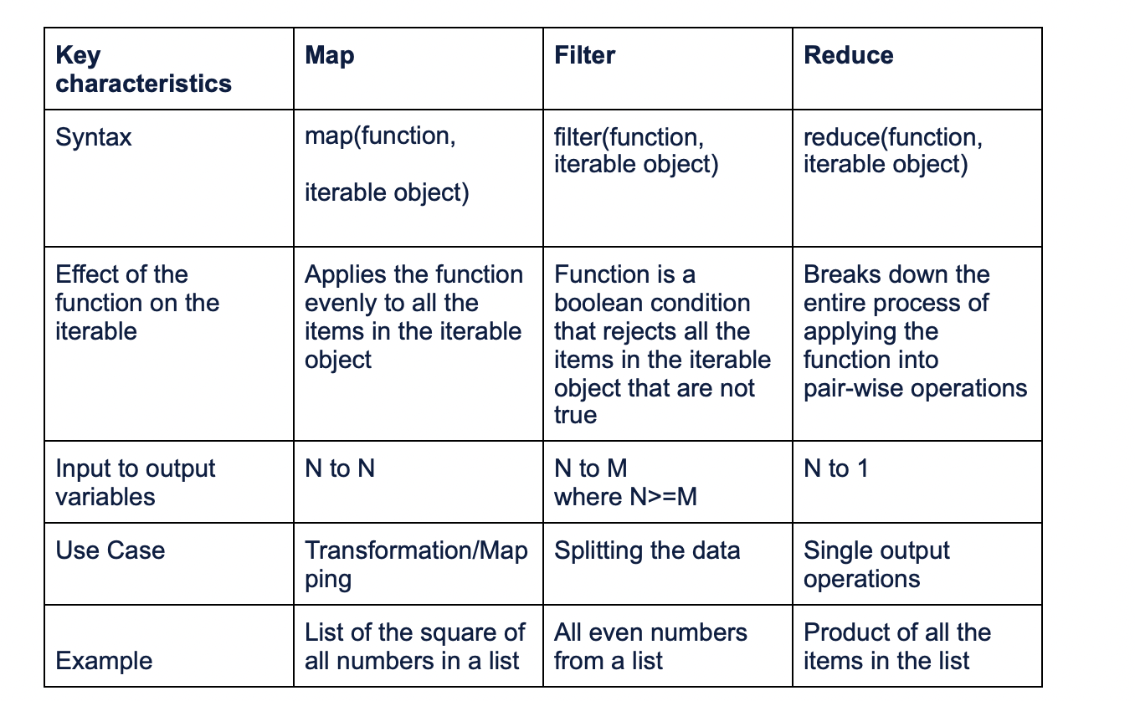
FILTER, MAP,REDUCE
A practical way to understand filter , map and reduce.

Slide 15
Combination of lambda with Map, reduce, filter.
Below are some program examples with map, reduce and filter.
MAP
REDUCE
MAP
FILTER
REDUCE
first_name="Keith","Elizabeth","Alex","William"]
last_name ="Philip","Brown","Smith","Oliver"]
name = list(map(lambda x, y:x+ " "+y, first_name, last_name))
name = list(map(lambda x, y:x+ " "+y, first_name, last_name))
Output:
first_name="Keith","Elizabeth","Alex","William"]
last_name ="Philip","Brown","Smith","Oliver"]
names = list(filter(lambda x: ( x[-1]=='h'),first_name))
print(names)
Output:
arr_num = [110,569, 784, 377, 900, 126]
largest_num = reduce(lambda x, y: x if x>y else y, arr_num)
print(largest_num)
Output:
900

Slide 16
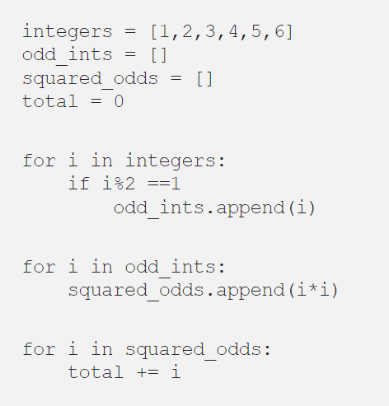
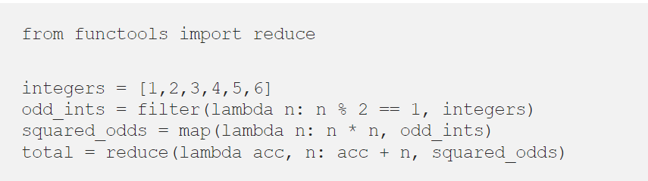

Abstracting loops in functional programming
Though both gives same result, the functional approach is much more shorter and easy to debug
A Functional approach
Thus, we are able to prove our second point of difference.
An object oriented approach
Is there any programming language which is purely functional?
What do you think? Lets find out….

Slide 17

The answer is yes, there is….
Haskell is a programming language which is purely functional.
Haskell is a preferred programming language nowadays primarily because it is statically typed.
The primary and unquestionable advantage of static typing is that it catches some of the bugs before the software is shipped to the users.
Haskell seems to be a cool language. Lets see some features of functional programming in Haskell.

Slide 18
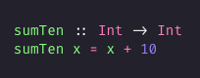
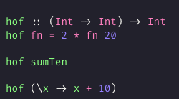
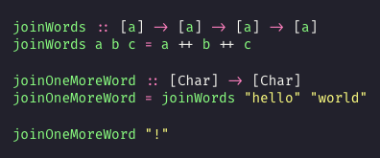
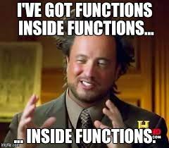
Functional Programming approach in Haskell
Simple function in Haskell
Function as Argument in Haskell.
\x is lambda function in haskell
Functions returning call of another function. Example of high order functionality.

Slide 19
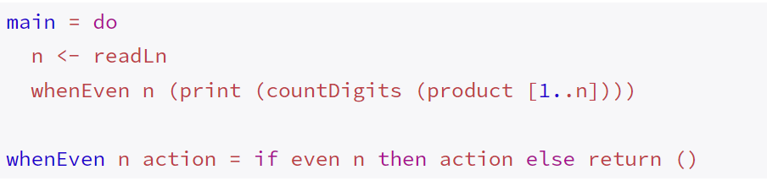
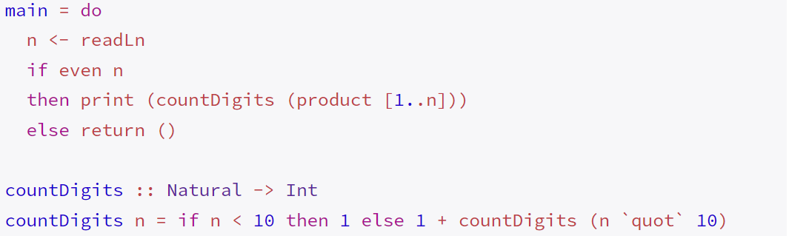
Why is Haskell so much in use?
Statically typed:- Haskell is a statically typed functional programming language, which means variables are explicitly declared . The primary and unquestionable advantage of static typing is that it catches some of the bugs before the software is shipped to the users. Furthermore, the developer can study the data model encoded in types to better understand the business domain.
Laziness : In Haskell, it is always valid to factor out subexpressions as a form of refactoring. For example:
Use of whenEven
Here use of whenEven function makes computation much more easier

Slide 20

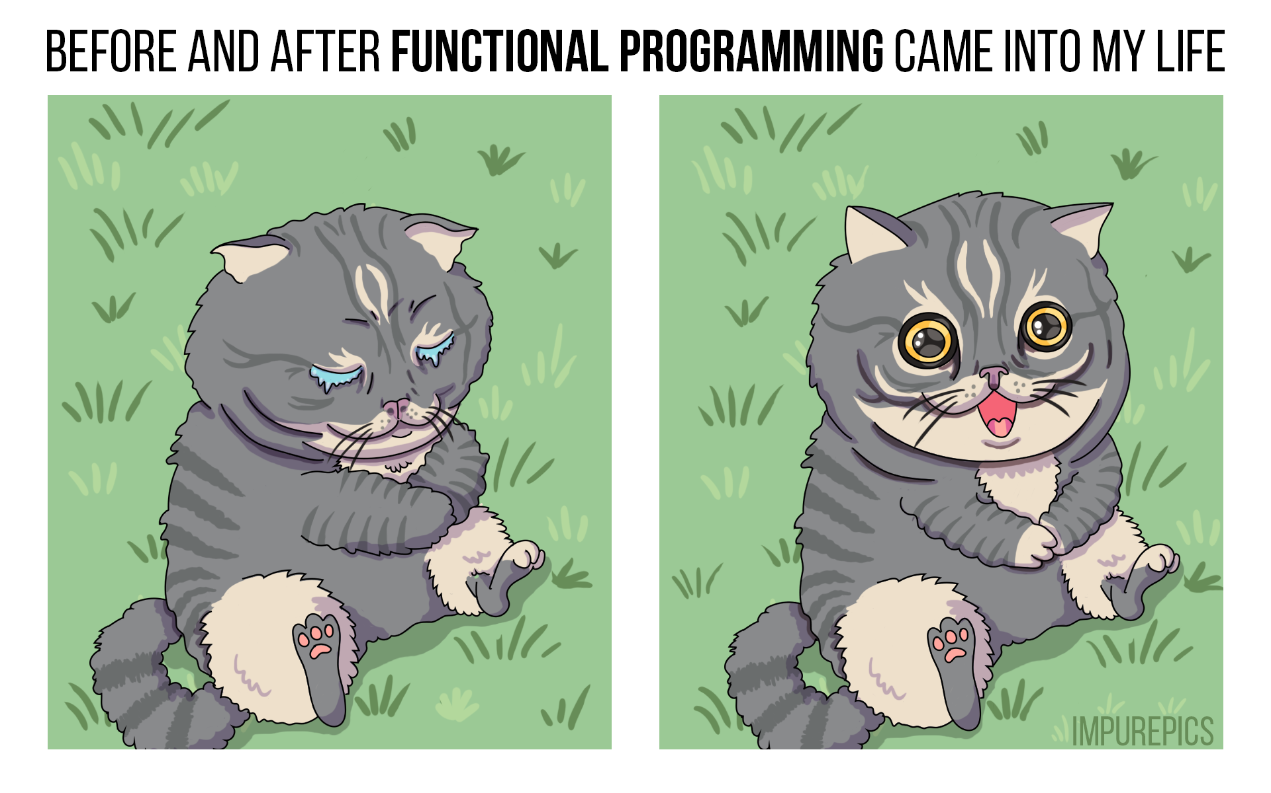
Advantages of Haskell…
Laziness:- Furthermore, laziness is basically a prerequisite for writing modular, reusable code.
Concurrency:- In many languages, concurrency is a never-ending source of issues, but in Haskell it is fairly straightforward. Green threads, amazing libraries such as async and stm, and ubiquity of pure functions make writing concurrent applications in Haskell a pleasure instead of a headache.
Other than these, purity of functions, immutability of variables make programming through Haskell easier and debugging of programs much more faster. This is the reason of subtle change in trend of coding community towards Functional programming.

Slide 21

CONCLUSION
Thus, due to the mentioned advantages and qualities of Functional Programming this paradigm is gaining new edge in modern day. Though Functional Programming is in an niche position compared to Object Oriented Programming, going totally functional might not be beneficial. Advent of Functional Programming aspects in C, C++, Python do surely makes tasks like debugging easy.
Even, Facebook uses Haskell for Spam Removal.
Cool isn’t it?

Slide 22

References used for this Presentation
Functional Programming & Haskell – Computerphile
https://www.analyticsvidhya.com/blog/2021/09/the-power-of-python-map-reduce-and-filter-functional-programming-for-data-science/
https://medium.com/@benjamin.b.phiri/pure-functions-vs-impure-functions-in-python-b2f009664ee4
https://serokell.io/blog/10-reasons-to-use-haskell
The End

